Slide 1


PRESENTATION ON
‘Online Based Grocery Market’
Group No: 01
Group members:
Shahrear, Faiyaz (18-38502-2)
Rahman, Shabrina (18-38514-2)
Rahman, Md Ashikur (18-38519-2)
Borno, Md Sabbir Hossain (18-38537-2)

Slide 2

Introduction
Application Logo
Project Name:
Online Based Grocery Market
Application Name:
The Farmhand
Slogan:
Save Farmers
Mission:
To be an everyday helping hand for farmers and customers
Vision:
To establish an easy platform between farmers and customer.

Slide 3
Why we choose this…
Farmers are not getting their real value for their product.
Products price are going upwards day by day.
People are getting more centralized and tended to leave villages.
Farmers are burning their crops for not getting their actual value.
Previous data says we may have to depend on foreign countries for these products.

Slide 4
Features OF SYSTEM
Real time update what farmers are providing and what customers are getting.
Full browsable database about the products.
a summery after every year to estimate the needs of each products so farmers can grow accordingly.
Real time connection between farmers and the product wholesaler/shopkeeper to stop the syndicate-abuses.
Automatically forwarding requests to the nearby agents.
Information/history on the amount of products farmers are growing all around the country.
Ensuring farmers getting real value for their products.

Slide 5
People working in this system
Agent
Appointed by company
Admin
System Owner/Company’s Employ
Customers
People with trade license

Slide 6
Features OF Customers
Any Customer (Shop kipper) can register and view available products.
Only registered member can purchase multiple products regardless of quantity.
Contact Us page is available to contact Admin for queries.
There are three roles available: User (Register user and Non-register user), Admin and Agent.
Non-register user can view available products. They can’t buy any product without register their account.
Register User can view and purchase products.

Slide 7
Features OF admin
Admin can add products, edit product information and add/remove
product.
Admin can remove user.
Admin can create their own account and edit their account.
Admin can see availability of any products and see stock products.
Admin can see farmer and agent details and also see the rating of agents and farmers.

Slide 8
Features OF agent
Agent can only see his order details.
Agent can input products details by using this system.
Agent can contact with Driver.
Agent can’t contact with another agent.

Slide 9



How System Works
1. Agent collects data from farmers and input to the system database
2. User Can order product.
3. Admin prepares transport system.
4. Request is forwarded to nearby Agents through system by automation technology.
6. Agent don’t get any allow/permission to know customer details and customer can't know agent details. All are kept safe in the system.
5. Agents allocates the amount he/she can provide and another nearby agent will help if first one can not fulfil the need.
7. System/Admins manages transport services.
8. User collects the product

Slide 10
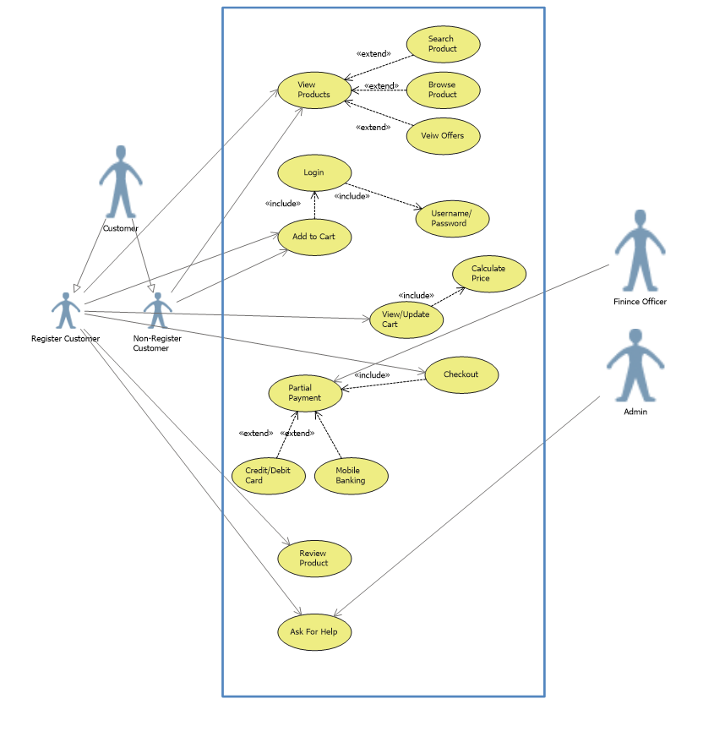
Use case diagram
Order Process

Slide 11
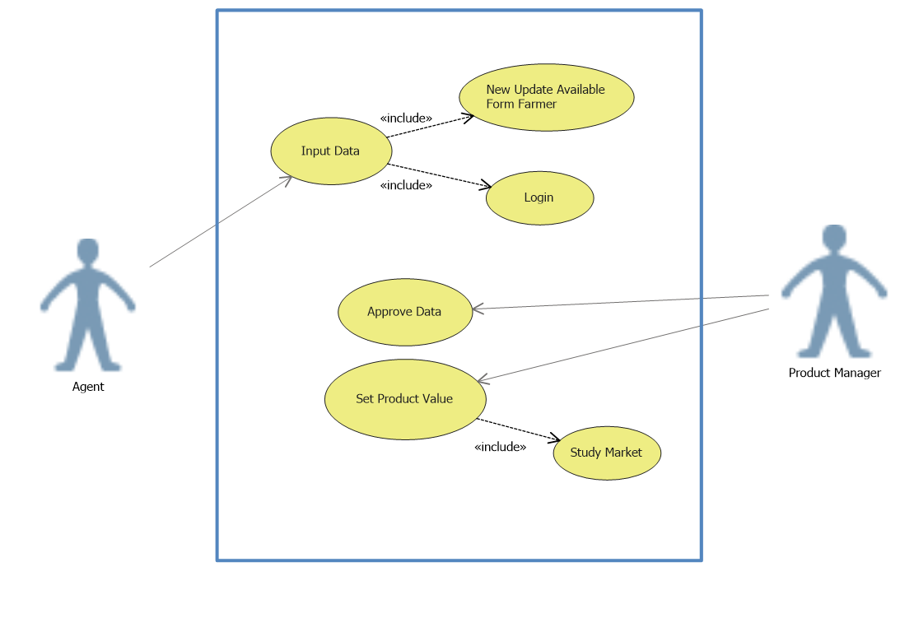
Use case diagram
Agent Data Input Process

Slide 12
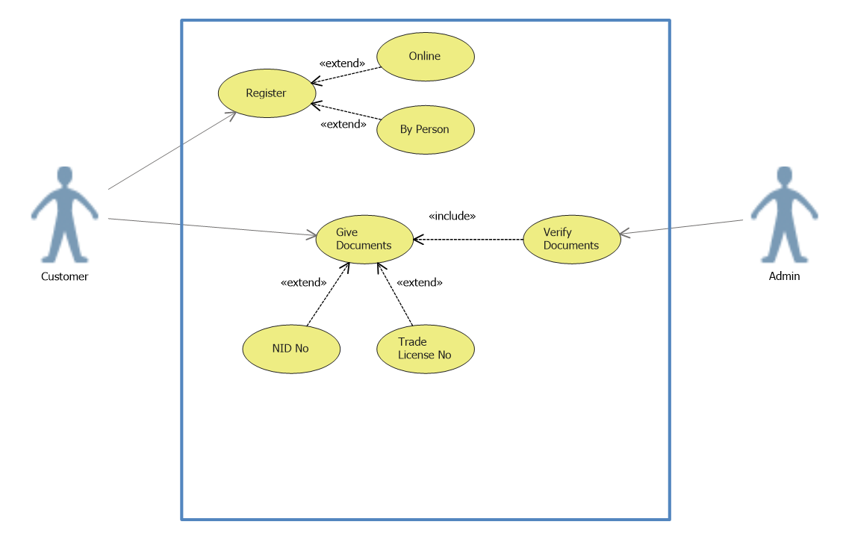
Use case diagram
Sing up Process

Slide 13
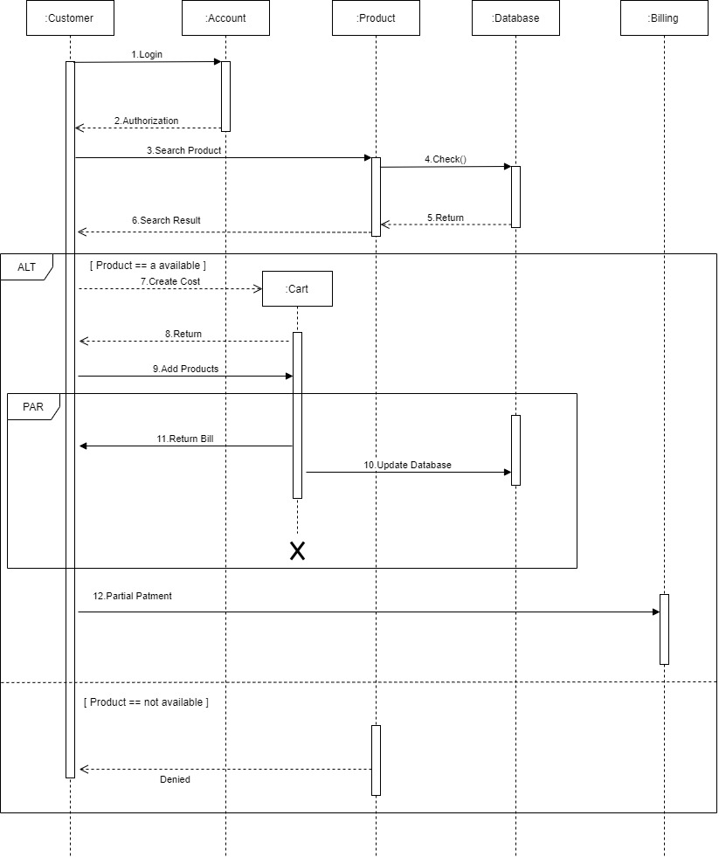
Sequence diagram
Order Process

Slide 14
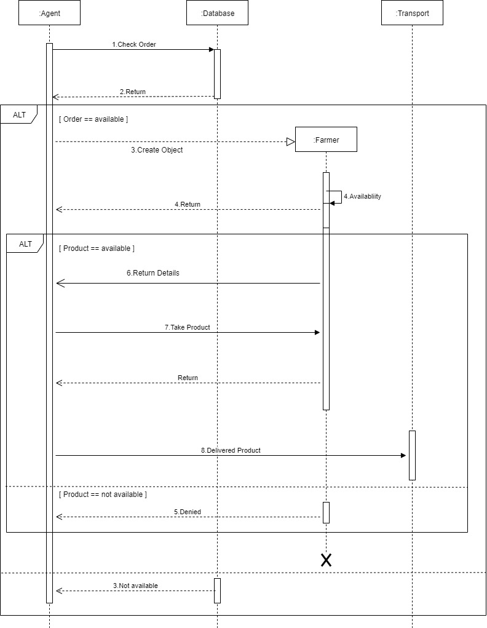
Sequence diagram
Agent to Transport Process

Slide 15
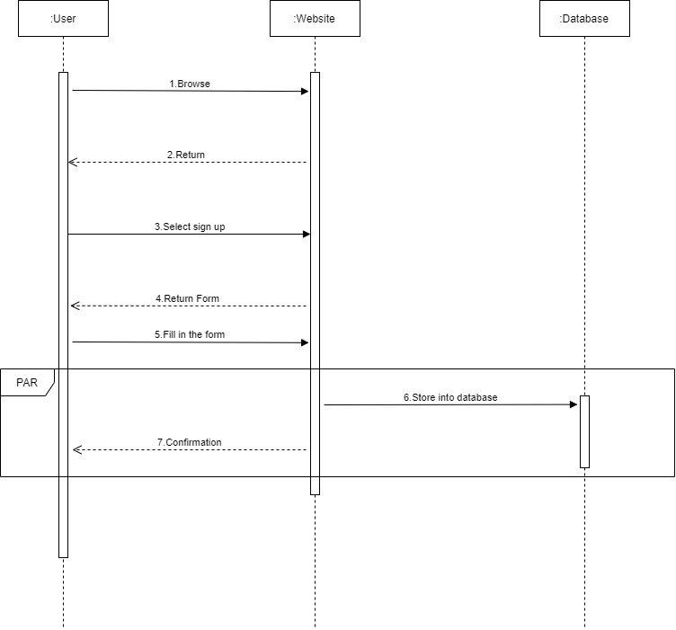
Sequence diagram
Sing up Process

Slide 16
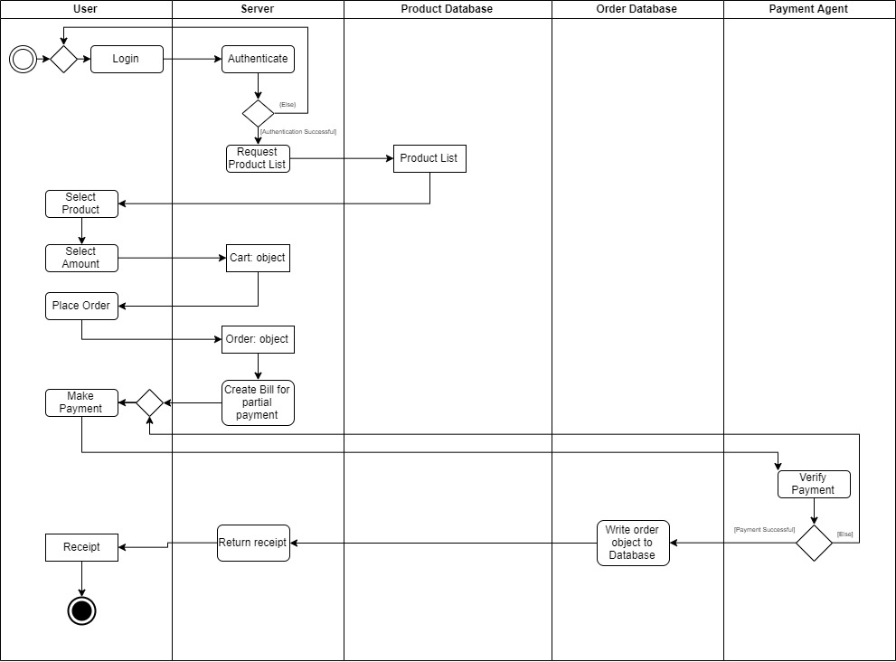
Activity diagram
Order Process

Slide 17
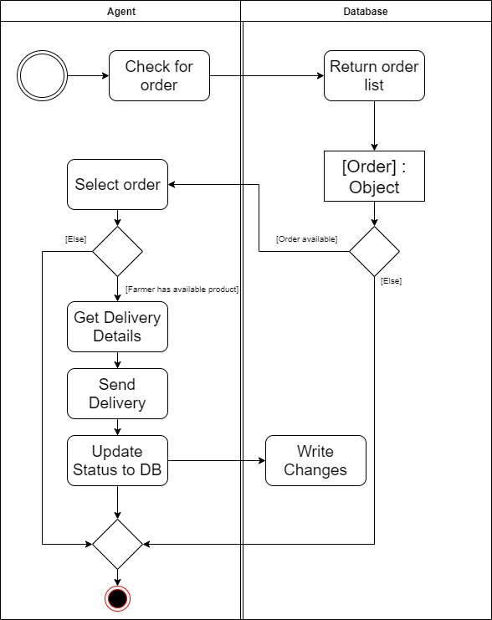
Activity diagram
Agent Order Manage Process

Slide 18
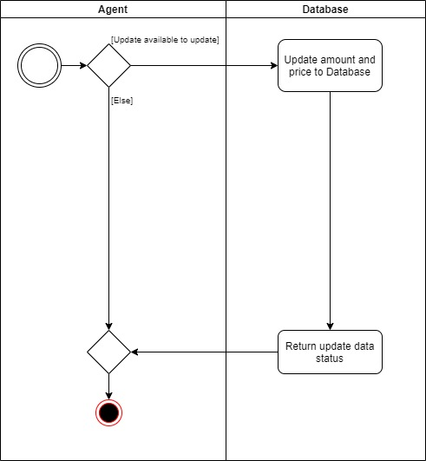
Activity diagram
Agent Input Data Process

Slide 19
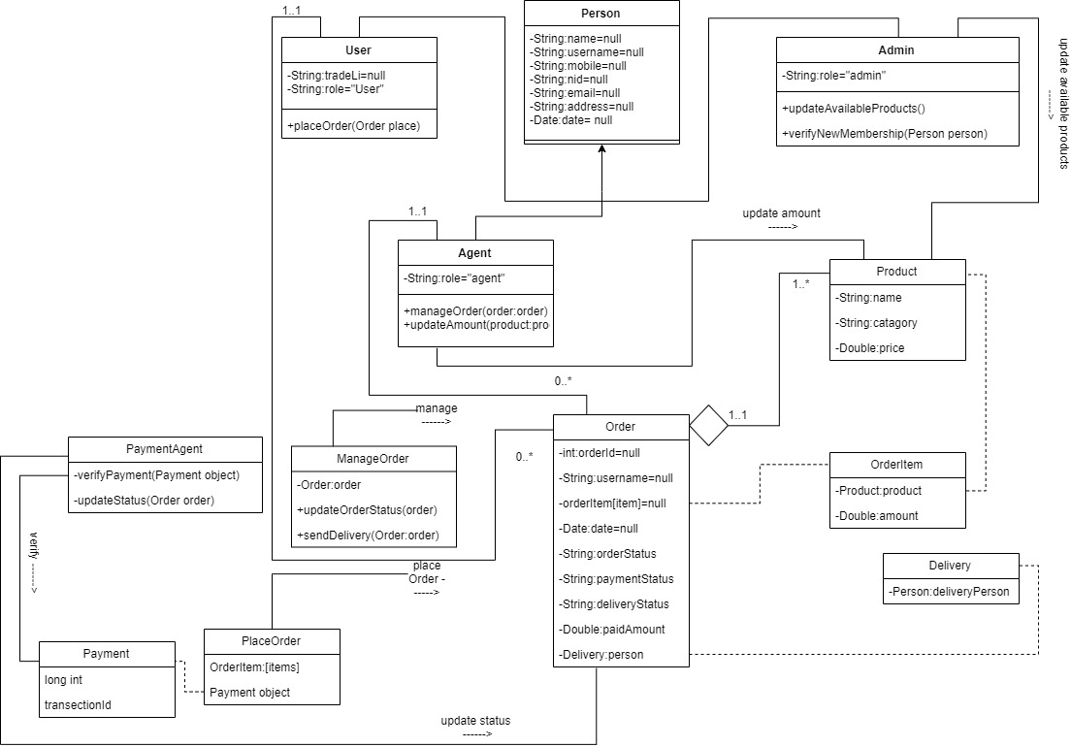
Class diagram

Slide 20
How we promote our system
WORD OF MOUTH
EVENT SPONSORSHIP
BRAND ACTIVISION
CONTENT MARKETING
VISUAL BRANDING
AUDIO BRANDING
VIDEO BRANDING
ONLINE REPRESENTATION

Slide 21
Costing for (for i.E.)Rice/kg
Paddy 23tk/kg
1Kg paddy = 0.6 Kg Rice
1Kg Rice = 1.67Kg Paddy
= 38tk/Kg
38 taka
0.125 taka
0.769 taka
0.96 taka
0.769 taka

Slide 22
Future planning
Provide loan to the farmers.
Add all grocery items gradually.
Provide service to entire country.
Export product to foreign countries if the project goes that far.

Slide 23
CONCLUSION
Technologies are blessing to us. By working on this project we have learned so many things that’ll help us to do more projects like this. Eventually we talked with the farmers personally to know every details. Our mission with this project is to provide our services to whole Bangladesh . We hope that if it works according to our mission, one day it will be able to balance the social inequality. We can solve unemployment problem by adding employment on this project. We believe “coming together is a beginning. Keeping together is progress. Working together is success.”

Slide 24
THANK YOU

Slide 25


